Slide 1

JAVA PROGRAMMING
1
UNIT - IV

Slide 2
UNIT - IV
2
□ Syllabus
Inheritance: Introduction to Inheritance, using super, creating a Multilevel Hierarchy, When Constructors are Called, Method Overriding, Dynamic Method Dispatch, Abstract Classes, final with Inheritance.

Slide 3
Inheritance
3
□ Defined as the process where one class acquires the properties (methods and fields) of another class.
□ The class which inherits the properties of other is known as subclass (derived class, child class)
□ the class whose properties are inherited is known as superclass {base class, parent class).
□ A subclass is a specialized version of a superclass. It inherits all of the instance variables and methods defined by the superclass and adds its own,unique elements.

Slide 4
Inheritance
• • •
□ To inherit a class, extends keyword is used.
□ Declaration of subclass that inherits a superclass is:
class subclassName extends superclassName {
// body of class
}
A simple Example of Inheritance.

Slide 5
class A { inti,j; void showij() { System.out.println(“i and j:” + I + ” “+j); } } class B extends A { int k; void showk() { System.out.println(“k: “+k); } void sum() { System.outprintln(“i + j+k:” +(i+j+k)); } } | class SimpleInheritance { public static void main(String args []) { A supob = new A( ); B subob = new B( ); supob.i = 7; supob.j = 8; System.out.println(”Contents of superobject is: ”); supob.showij(); System.out.println(); subob.i = 7; subob.j = 8; subob.k=9;

Slide 6
System.out.println(“Contents of subobject is: ”);
subob.showij();
subob.showk();
System.out.println();
System.out.println(”Sum of i ,j and k in subob:"); subob.sum();
}
}
OUTPUT:
Content of superob: i and j: 7 8
contents of subob: i and j : 7 8
k:9
Sum of i,j and k in subob:
i+j+k:24

Slide 7
Example - Creates superclass called A and a
subclass called B.
5
class A { // Create a superclass.
int a;
void dispa() {
System.outprintln(“a:" + a );
}
}
class B extends A { // Create a subclass by extending class A.
int b;
void dispb() {
System.outprintln(“b: ” + b);
}
void sum() {
System.outprintln(“a+b: ” + (a+b));
}
}

Slide 8
Example - creates a superclass called A and a
subclass called B.....
6
class SimpleInheritance {
public static void main(String args []) {
B subob = new B( );
subob.a = 7;
subob.b = 8;
System.out.println(”Contents of a and b are: ”);
subob.dispa();
subob.dispb();
System.out.println();
System.out.println(”Sum of a and b is:”); subob.sum();
}
}

Slide 9
Member Access and Inheritance
7
□ A subclass includes all of the members of its superclass, it cannot access those members of the superclass that have been declared as private.
□ i.e A class member that has been declared as private will remain private to its class. It is not accessible by any code outside its class, including subclasses.

Slide 10
Example : Member Access and Inheritance ...
8
// Create a superclass. class A {
int a; // public by default
private int pa; // private to A
void setap(int x, int y) { a = x; pa = y;
}
}
class B extends A
{ // A’s pa is not accessible here.
int total;
void sum() {
total = a + pa; // ERROR, pa is not accessible here
}
}

Slide 11
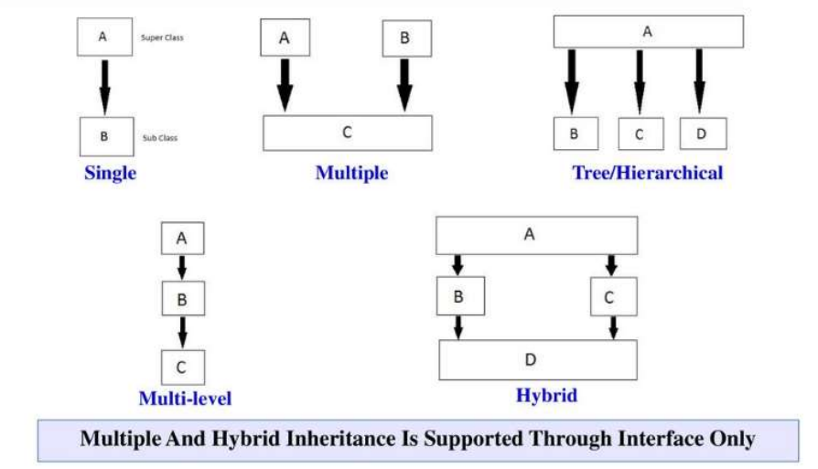
Types of Inheritance:
● Single Inheritance
● Multilevel Inheritance
● Multiple inheritance
● Hierarchical Inheritance
● Hybrid Inheritance

Slide 12
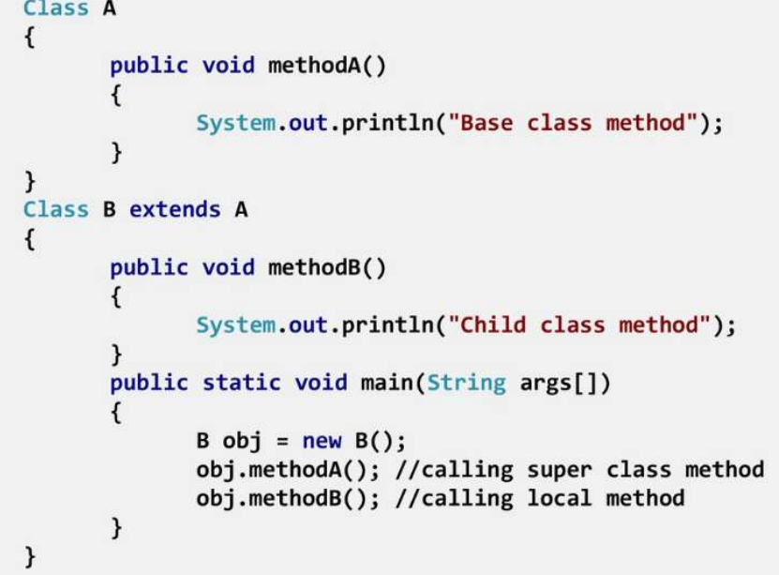
Single inheritance:
When a class extends another one class only then we call it a single inheritance.
The below flow diagram shows that class B extends only one class which is A.
Here A is a parent class of B and B would be a child class of A.

Slide 13
Creating a Multilevel Hierarchy
9
□ We have been using simple class hierarchies that consist of only a superclass and a subclass.
□ A subclass inheriting the properties from its super class inturn superclass inheriting the properties from its super class is called as mutlilevel inheritance.
□ As mentioned, it is perfectly acceptable to use a subclass as a superclass of another.
□ For example, given three classes called A, B, and C, C can be a subclass of B, which is a subclass of A.
□ When this type of situation occurs, each subclass inherits all of the traits found in all of its super classes. In this case, C inherits all aspects of B and A.

Slide 14
Example
10
class A { int a;
void dispa() {
System.out.println(“a ” + a);
}
}
class B extends A { int b;
void dispb() {
System.outprintln(“b: ” + b);
}
}
class C extends B { int c;
void dispc() {
System.outprintln(“c: ” + c);
}

Slide 15
Example
11
void sum() {
System.outprintln(“a+b+c: " + (a+b+c));
}
} // end of class C
class MultilevelInheritance {
public static void main(String args[]) {
C subOb = new C();
subOb.a = 7;
subOb.b = 8;
subOb.c =9 ;
System.out.println("Contents of a, b and c are: ");
subOb.dispa();
subOb. dispb();
subOb. dispc();
System.out.println("Sum of a ,b and c is:"); subOb.sum();
}
}

Slide 16
Hierarchical Inheritance:
The type of inheritance where many subclasses inherit from one single class is known as Hierarchical Inheritance.
Multiple subclasses inheriting the properties from only one super class or common superclass is called as Hierarchical Inheritance.
It is different from the multilevel inheritance, as the multiple classes are being derived from one superclass.
These newly derived classes inherit the features, methods, etc, from this one superclass.
This process facilitates the reusability of a code and dynamic polymorphism (method overriding).

Slide 17
// Java program to illustrate the concept of Hierarchical inheritance
class A {
public void print_A() {
System.out.println("Class A");
}
}
class B extends A {
public void print_B() {
System.out.println("Class B");
}
}
class C extends A {
public void print_C() {
System.out.println("Class C");
}
}
class D extends A {
public void print_D() {
System.out.println("Class D");
}
}

Slide 18
public class Hierarchical {
public static void main(String[] args)
{
B obj_B = new B();
obj_B.print_A();
obj_B.print_B();
C obj_C = new C();
obj_C.print_A();
obj_C.print_C();
D obj_D = new D();
obj_D.print_A();
obj_D.print_D();
}
}
OUTPUT:
Class A
Class B
Class A
Class C
Class A
Class D

Slide 19
Multiple Inheritance :
Multiple inheritances is a type of inheritance where a subclass can inherit features from more than one parent class.
A subclass inheriting the properties from multiple super classes is called as multiple inheritance.
In multiple inheritances the newly derived class can have more than one superclass. And this newly derived class can inherit the features from these super classes it has inherited from, so there are no restrictions.
We can't achieve multiple inheritance through classes but we can achieve through Interface.

Slide 20
Hybrid Inheritance:
Hybrid inheritance is a combination of more than two types of inheritances single and multiple.
It can be achieved through interfaces only as multiple inheritance is not supported by Java.
It is basically the combination of simple, multiple, hierarchical inheritances.

